Slide 1



Context Window
System prompt
WhatsApp
Telegram
Discord
WeChat
QQ
Web UI
…
…
Claude
GPT
Gemini
…
OpenClaw
Cloud / Local

Slide 2
Context Window
System prompt
Select what to show the model
(keep it neither too long nor too short)
WhatsApp
Telegram
Discord
WeChat
QQ
Web UI
…
…
Claude
GPT
Gemini
…
OpenClaw
Cloud / Local

Slide 3
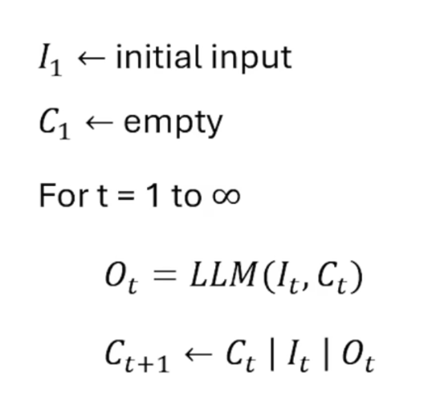
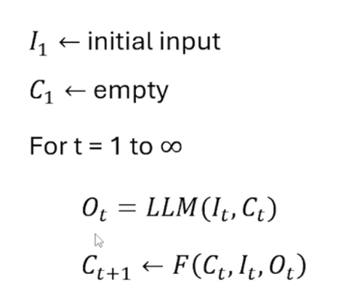
Input
Context
Output

Slide 4
System prompt
WhatsApp
Telegram
Discord
WeChat
QQ
Web UI
…
message
Claude
GPT
Gemini
…
OpenClaw
Cloud / Local

Slide 5
System prompt
“There used to be tool output here. ”
[…]
WhatsApp
Telegram
Discord
WeChat
QQ
Web UI
…
message
Claude
GPT
Gemini
…
OpenClaw
Cloud / Local

Slide 6
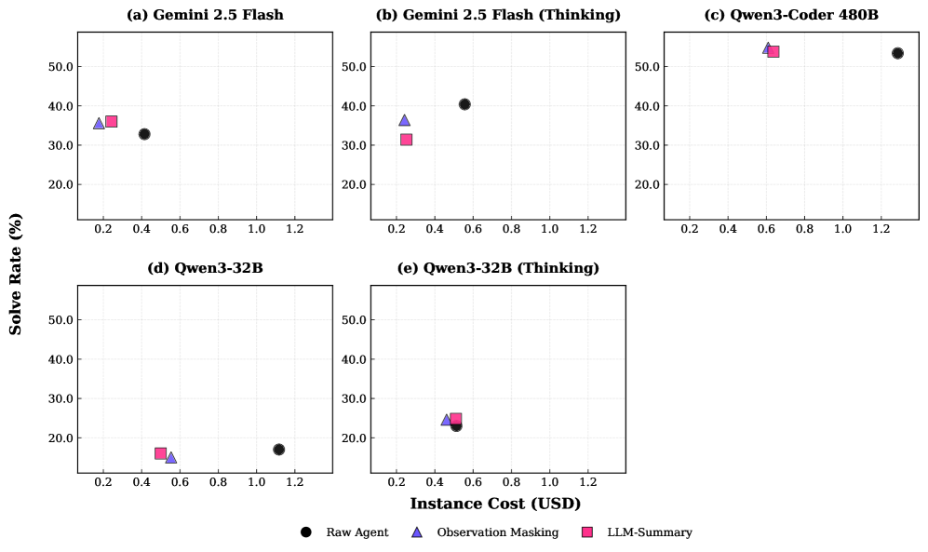
The Complexity Trap: Simple Observation Masking Is as Efficient as LLM Summarization for Agent Context Management (2025)

Slide 7
The Complexity Trap: Simple Observation Masking Is as Efficient as LLM Summarization for Agent Context Management (2025)

Slide 8
The Complexity Trap: Simple Observation Masking Is as Efficient as LLM Summarization for Agent Context Management (2025)

Slide 9
System prompt
“There used to be tool output here. ”
[…]
WhatsApp
Telegram
Discord
WeChat
QQ
Web UI
…
message
Claude
GPT
Gemini
…
OpenClaw
Cloud / Local

Slide 10

“There used to be tool output here.
See details in log1.txt.”
System prompt
[…]
[tool_use] Read(log1.txt)
WhatsApp
Telegram
Discord
WeChat
QQ
Web UI
…
Claude
GPT
Gemini
…
OpenClaw
Cloud / Local
https://manus.im/blog/Context-Engineering-for-AI-Agents-Lessons-from-Building-Manus
Solving Context Window Overflow in AI Agents (2025)

Slide 11
System prompt
Context
when/how to save
to memory …
WhatsApp
Telegram
Discord
WeChat
QQ
Web UI
…
Claude
GPT
Gemini
…
OpenClaw
Cloud / Local
A-MEM: Agentic Memory for LLM Agents (2025)
Mem0: Building Production-Ready AI Agents with Scalable Long-Term Memory (2025)
Memory OS of AI Agent (2025)

Slide 12
System prompt
Context
when/how to load
to memory …
WhatsApp
Telegram
Discord
WeChat
QQ
Web UI
…
Claude
GPT
Gemini
…
from memory …
OpenClaw
Cloud / Local
A-MEM: Agentic Memory for LLM Agents (2025)
Mem0: Building Production-Ready AI Agents with Scalable Long-Term Memory (2025)
Memory OS of AI Agent (2025)

Slide 13
File System
(Add graph, time …)
System prompt
Context
when/how to load
to memory …
WhatsApp
Telegram
Discord
WeChat
QQ
Web UI
…
Claude
GPT
Gemini
…
from memory …
OpenClaw
Cloud / Local
A-MEM: Agentic Memory for LLM Agents (2025)
Mem0: Building Production-Ready AI Agents with Scalable Long-Term Memory (2025)
Memory OS of AI Agent (2025)

Slide 14
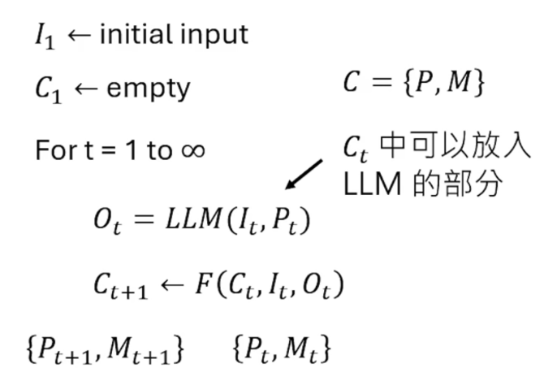
Input
Context
Output
Prompt
Memory
Context
Context

Slide 15
Input
Context
Output
Prompt
Memory
Context
Content in Ct that
can be fed into the LLM
Context

Slide 16
Input
Context
Output
Prompt
Memory
Context
Content in Ct that
can be fed into the LLM

